Slide 1
Principles of programming
Lab 3

Slide 2
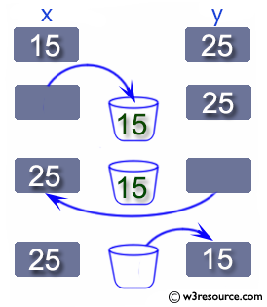
Ex1
Write a Java program to swap two variables.
Before swapping : a, b = 15, 27
After swapping : a, b = 27, 15

Slide 3
public class Exercise {
public static void main(String[] args) {
// int, double, float
int a, b, c;
a = 15;
b = 27;
System.out.println("Before swapping : a, b = "+a+", "+ + b);
c = a;
a = b;
b = c;
System.out.println("After swapping : a, b = "+a+", "+ + b); } }

Slide 4
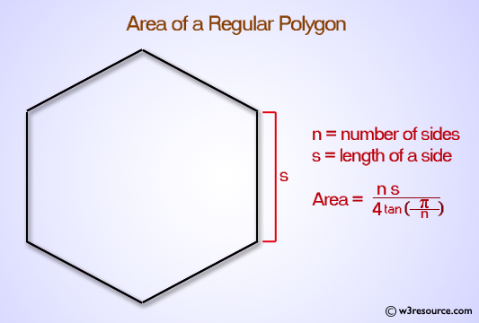
Ex2
Write a Java program to compute the area of a polygon.
Area of a polygon = (n*s^2)/(4*tan(π/n)) where n is n-sided polygon and s is the length of a side.
Input the number of sides on the polygon: 7
Input the length of one of the sides: 6
The area is: 130.82084798405722

Slide 5
import java.util.Scanner;
public class Exercise {
public static void main(String[] args) {
Scanner input = new Scanner(System.in); System.out.print("Input the number of sides on the polygon: ");
int ns = input.nextInt();
System.out.print("Input the length of one of the sides: ");
double side = input.nextDouble();
double polygonArea = (ns * (side * side)) / (4.0 * Math.tan((Math.PI / ns));
System.out.print("The area is: " + polygonArea+"\n"); }

Slide 6
Ex3
Write a Java program to print the following string in a specific format (see the output).
Twinkle, twinkle, little star,
How I wonder what you are!
Up above the world so high,
Like a diamond in the sky.
Twinkle, twinkle, little star,
How I wonder what you are

Slide 7
public class Example43 {
public static void main(String[] args) {
System.out.println("\nTwinkle, twinkle, little star, \n\tHow I wonder what you are! \n\t\tUp above the world so high, \n\t\tLike a diamond in the sky. \nTwinkle, twinkle, little star, \n\tHow I wonder what you are!\n\n");
}
}

Slide 8
Ex 4
Write a Java program that accepts an integer (n) and computes the value of n+nn+nnn.
Input number: 5
Output: 5 + 55 + 555

Slide 9
import java.util.Scanner;
public class Exercise44 {
public static void main(String[] args) {
int n;
Scanner in = new Scanner(System.in);
System.out.print("Input number: ");
n = in .nextInt();
System.out.printf("%d + %d%d + %d%d%d\n", n, n, n, n, n, n);
}
}

Slide 10
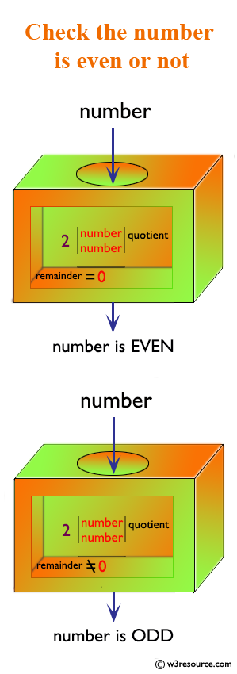
Ex5
Write a Java program to accept a number and check the number is even or not. Prints 1 if the number is even or 0 if the number is odd.

Slide 11
import java.util.*;
public class Exercise49 {
public static void main(String[] args){
Scanner in = new Scanner(System.in); System.out.print("Input a number: ");
int n = in.nextInt();
if (n % 2 == 0) {
System.out.println(1); }
else {
System.out.println(0); }
}
}

Slide 12
Ex6
Write a Java program to calculate the sum of two integers and return true if the sum is equal to a third integer.

Slide 13
public class ee {
public static void main(String[] args) {
// TODO Auto-generated method stub
Scanner in = new Scanner(System.in);
System.out.print("Input the first number : ");
int x = in.nextInt();
System.out.print("Input the second number: ");
int y = in.nextInt();
System.out.print("Input the third number : ");
int z = in.nextInt();
boolean result = ((x + y) == z || (y + z) == x || (z + x) == y);
System.out.print("The result is: "+ result);
System.out.print("\n");
}
}

Slide 14
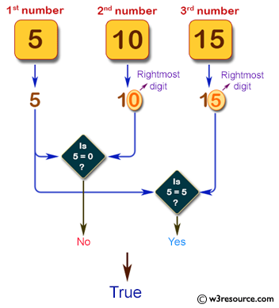
Ex 7
Write a Java program that accepts three integers from the user and return true if two or more of them (integers ) have the same rightmost digit.
Input the first number : 5
Input the second number: 10
Input the third number : 15
The result is: true

Slide 15
import java.util.*;
public class ee {
public static void main(String[] args) {
Scanner in = new Scanner(System.in);
System.out.print("Input the first number : ");
int x = in.nextInt();
System.out.print("Input the second number: ");
int y = in.nextInt();
System.out.print("Input the third number : ");
int z = in.nextInt();
boolean test_last_digit = (x % 10 == y % 10) || (x % 10 == z % 10) || (y % 10 == z % 10);
System.out.print("The result is: "+test_last_digit);
System.out.print("\n");
}
}

